Slide 1


GOVERNMENT RESIDENTIAL POLYTECNIC FOR WOMEN
SHIVAMOGGA-577205
CAPSTONE PROJECT ON
“Stock Market Price Prediction Using Machine Learning”
BY
DANIYA 135CS21009
KAVANA B B 135CS21015
RAMYA 135CS21042
SHARANYA 135CS21046
Under The Guidance Of
Sri. Hanumanthappa.G
_{M.Tech, (Ph.D).,}
Cohort Owner
DEPARTMENT OF COMPUTER SCIENCE AND ENGINEERING
2023-2024

Slide 2

Introduction to Stock Market Price Prediction
An overview of the project to predict stock market prices using machine learning models.

Slide 3

Problem Statement
Stock market prices are influenced by a multitude of factors, making them challenging to predict accurately with traditional methods. Our goal is to leverage the capabilities of Machine Learning to create a robust predictive model that outperforms existing approaches, providing investors and financial analysts with a valuable tool for decision-making.

Slide 4

What is Trading Or Stock?
A stock represents a share in the ownership of a company, including a claim on the company's earnings and assets. As such, stockholders are partial owners of the company. When the value of the business rises or falls, so does the value of the stock.
stock exchanges are :- NSE, MSE,BSE ect..
Indian stock market opening & closing time
The normal trading session is known as a continuous trading session. The trading time in India runs from 9.15 am to 3.30 pm. Traders can buy and sell shares without any restrictions during this time.

Slide 5
Data engineering pipeline
1
Data collection
2
Exploratory Data Analysis (EDA)
The first step of every project is to collect the data. We collected our data from Kaggle. You can find the dataset
Explore the cleaned and transformed data to gain insights and identify patterns.
3
4
Data Integration and Reduction
Data Preprocessing
Data cleaning, Removing outliers and handling missing data to ensure data quality.
Data integration and reduction are both important processes in data preprocessing, aimed at improving the quality and efficiency of data analysis.
5
Feature Scaling
6
Data Splitting
Standardization, and normalization are techniques used to preprocess numerical features in machine learning
Spliting the data into training, validation, and test sets.
8
Model Evaluation
7
Training the Model
Evaluate the trained model(s) on the test set to assess its performance on unseen data.
Train the selected machine learning algorithm(s) using the training data.

Slide 6
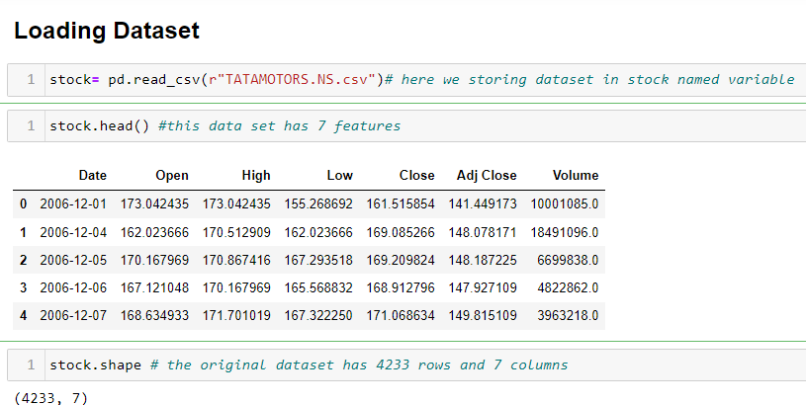
Data Collection
For this model we taken “TATA Motors Limited - Stock ” .This dataset contains the historical stock prices of Tata Motors Limited in INR on a daily basis. The stock prices was collected through kaggle.
Ticker symbol is - TATAMOTORS.NS .csv
This dataset as 7 features that’s are Date , Open , High , Low & ADJ Close Volume
This dataset as stock price records from 2006 to 2024, it means 18 year’s .
And it as 4233 rows and 7 columns/feature

Slide 7
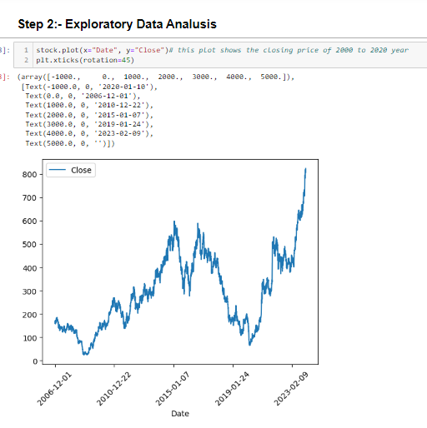
Exploratory Data Analysis (EDA)
In this step, we use weary plotting techniques to visualize how the stock price varies between high and low in the Open and Close columns .
We understand that from 2006 to 2010, the stock price had low volume. However, starting from the beginning of 2010 through 2019, the stock price showed a significant increase
From the last month of 2019 to 2022, the stock price of Tata Motors significantly decreased.
But at the start of 2023, the stock price did not decrease and instead continued to rise.

Slide 8
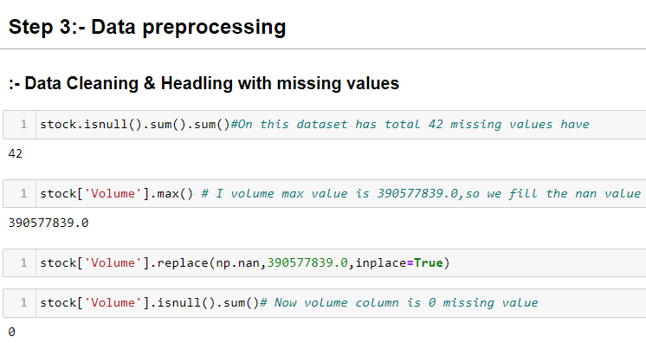
Data Preprocessing
In this step , we Handle the missing values in this dataset
In this dataset has total 42 missing values have
Expect Data column all the Column have 7 missing values
we check the duplicated value on this data set but it has 0 duplicate
To handle the missing value it have two ways that is drop the missing value or replace the dataset
We replace the missing value on volume column using median value
And the last we drop the null values using “dropNA” function " correct the words

Slide 9
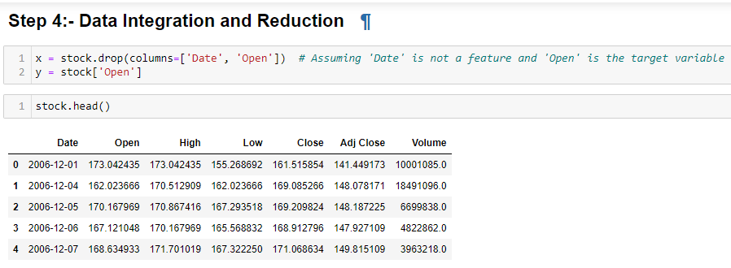
Data Integration and Reduction
In this step, We reduce the Date and Open features because of the “X” variable contains independent feature, So we drop the dependent columns
“ Y ” ,We only use the dependent column / feature that is Open

Slide 10
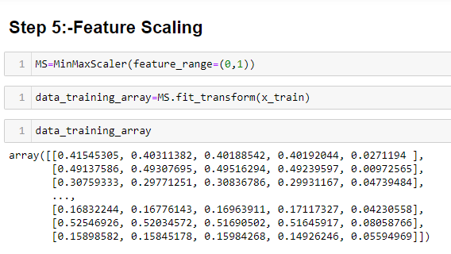
Feature Scaling
We use Min-Max Scaler technique, is indeed a method used for feature scaling feature Scaling, which transforms the dataset values to a specified range, typically 0 to 1.

Slide 11
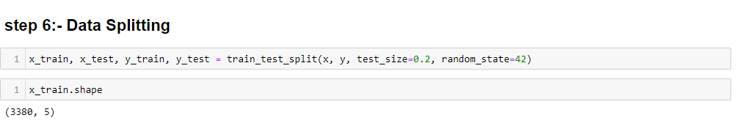
Data Splitting
For this dataset we Splits the Data into 2 part training set and testing set
In training data it have 80% of data for training
And for testing it have 20% of dataset

Slide 12

Machine Learning Models Used
1
Linear Regression
Simple yet effective for modeling stock price movements
2
Random Forest
Handling non-linear relationships and high-dimensional data
3
Decision Tree
It is a fundamental machine learning model used in various prediction tasks, including stock market price prediction.
5
Gradient Boosting
Boosting ensemble method for improved prediction accuracy

Slide 13

Comparison of All Models
Models | Prediction Image | R2_Score | Mean_Error
Linear Regression |  | 0.9996879588134863 | 7.921910545531257
Random Forest |  | 0.9994289219415903 | 14.325518609487622
Decision Tree |  | 0.9980859281227569 | 13.5578552255873552
Gradient Boosting |  | 0.9252252253784354 | 1705.6295461563584

Slide 14

Conclusion
In this project we used four regression technique for Training the model And we have taken TATA Motors stock dataset and we train our model.
We split the data into 80% for training and 20% for testing.
We used machine learning algorithms & it’s R2 scores are, The R2 scores of Linear Regression (0.9997) , Random Forest (0.9994), Decision Tree (0.9981) and Gradient Boosting Regression (0.9252).
The R2 score of Linear Regression is more than other models and mean error is less compared to other models. So Linear Regression is the best model.

Slide 15
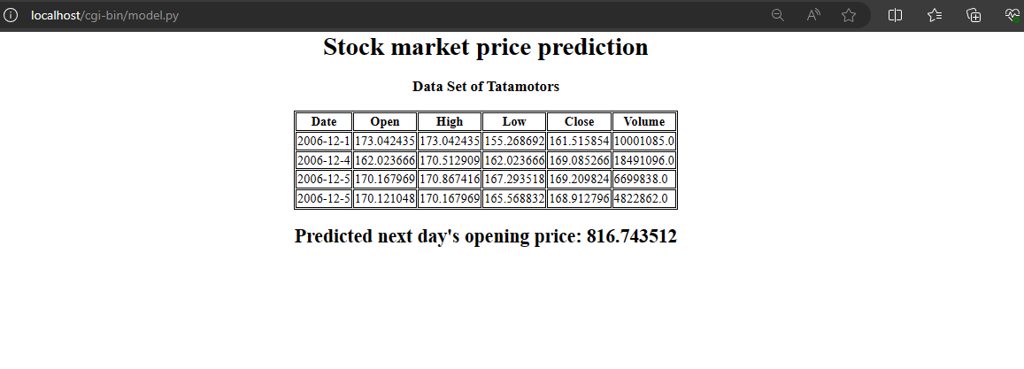
WEB PAGE OF STOCK MARKET PRICE PRIDECTION

